Slide 1

TEXAS BASKETBALL
FOR QUESTIONS
EMAIL: HARRISDR@UTEXAS.EDU
512.471.5816

Slide 2
Book Recommendations
Mindset by Carol Dweck
Power of Intention by Wayne Dyer
The Rhythm of Life by Matthew Kelly

Slide 3

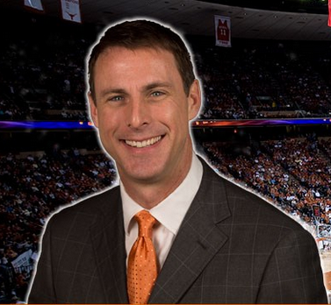
Darrin Horn
Assistant Coach

Slide 4
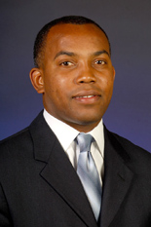
David Cason
Assistant Coach

Slide 5
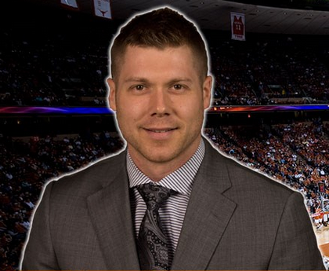
Mike Morrell
Assistant Coach

Slide 6
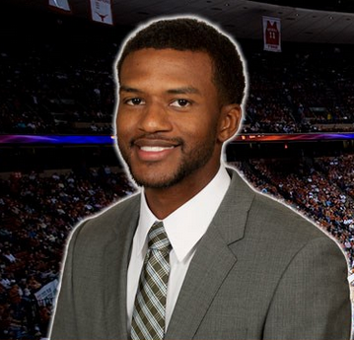
Jai Lucas
Director of Operations

Slide 7
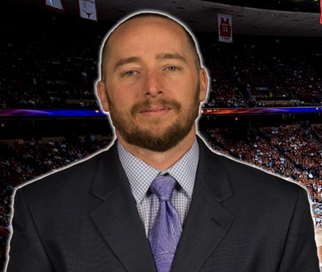
Daniel Roose
Head Strength & Conditioning Coach

Slide 9
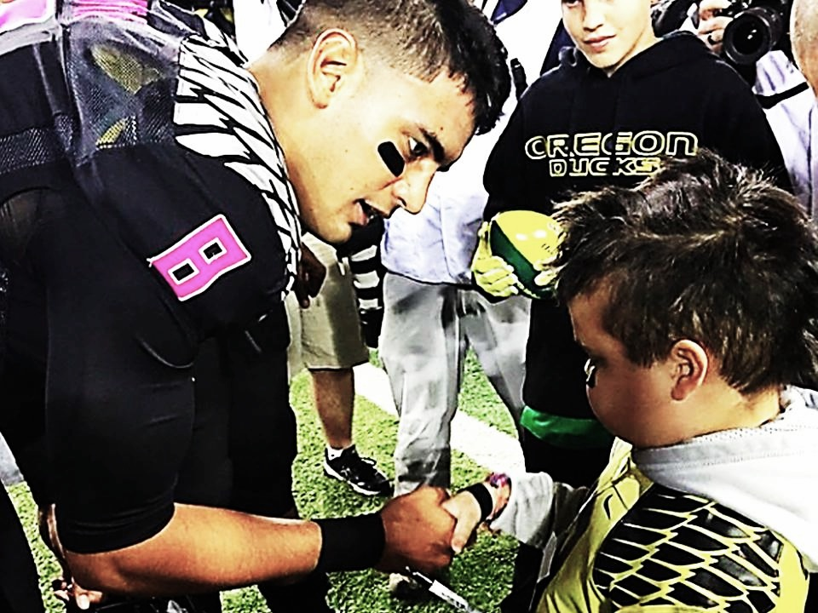
APPRECIATION

Slide 10
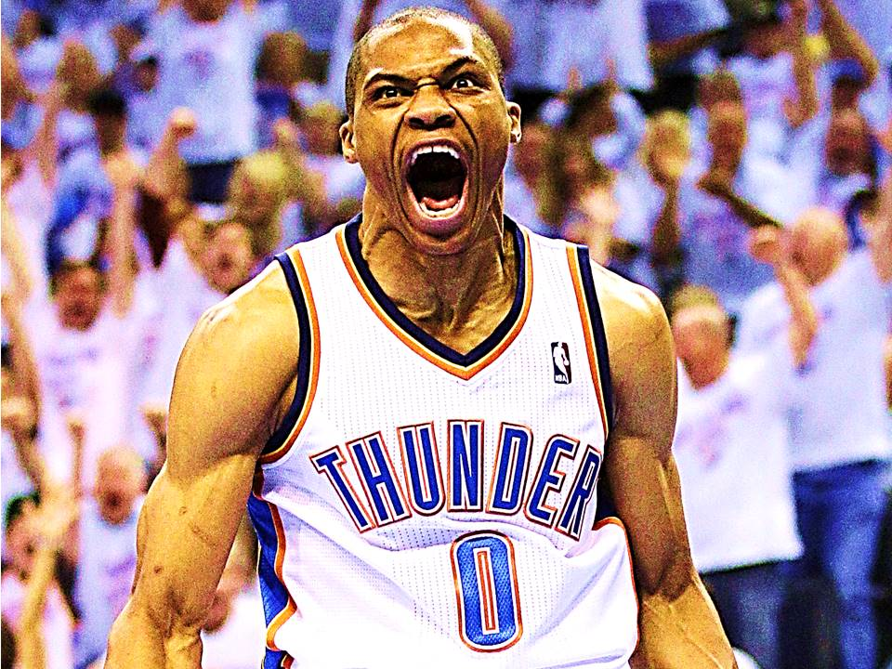
ENTHUSIASM

Slide 11
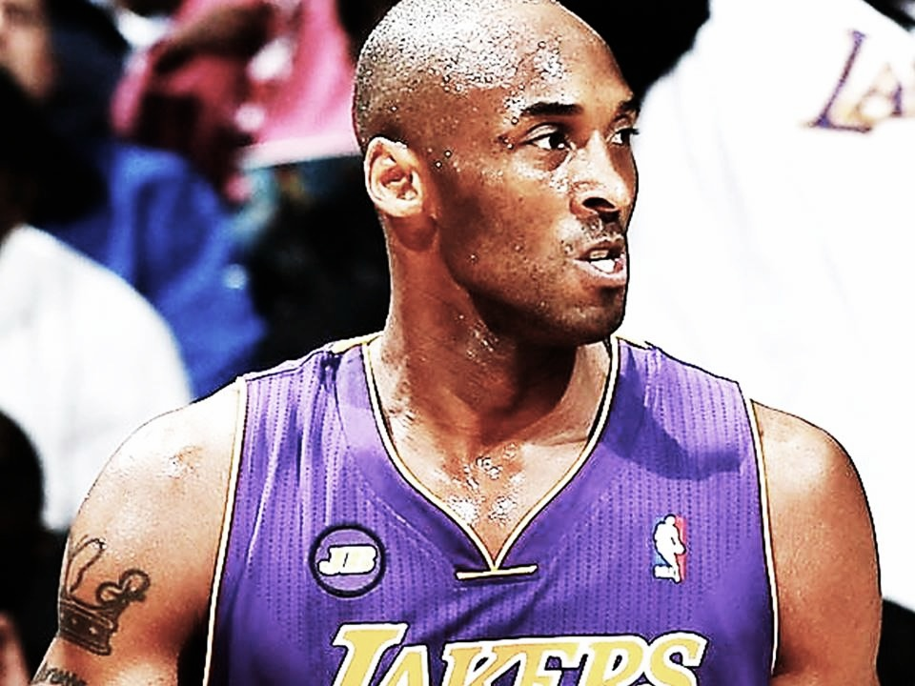
COMPETITIVENESS

Slide 12
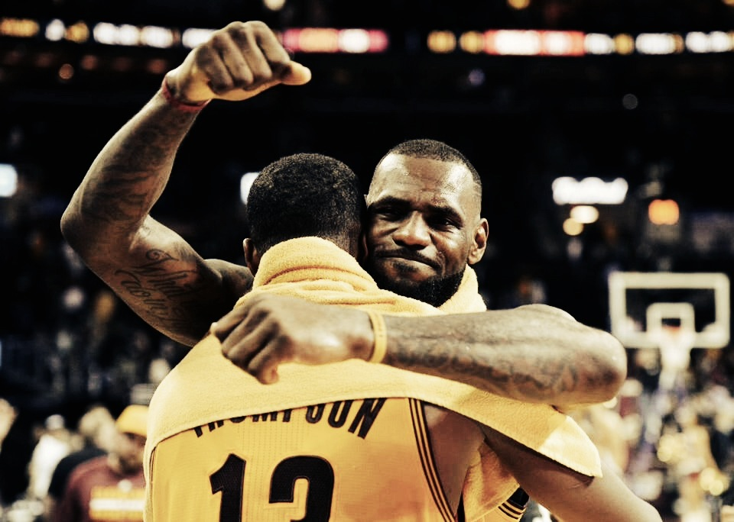
TEAMSHIP

Slide 13
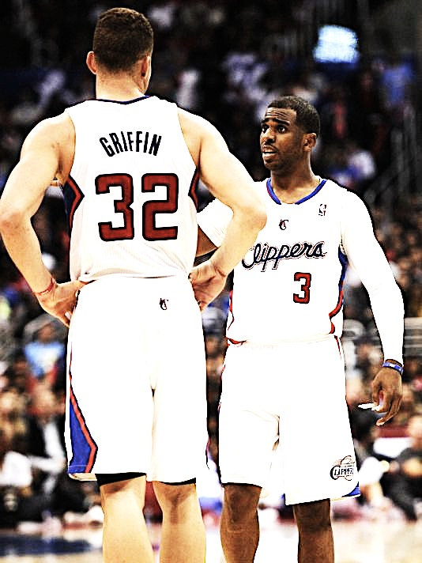
ACCOUNTABILITY

Slide 14
COMPETITIVE CHARACTER

Slide 15
“DO YOUR HABITS MATCH YOUR EXPECTATIONS”
- JEROME ALLEN
(Expectations Questionnaire)

Slide 16
COACHABILITY
The willingness to be corrected and act on that correction. When we are coachable, we are prepared to be wrong.
Capacity of being easily taught and trained to do something better.
“More opportunities come to those who are willing to be taught.” – Kobe Bryant
“What do you do with a mistake: Recognize it, Admit it, Learn from it.” – Dean Smith

Slide 17
COACHABILITY
3 Keys to Coachability Traits:
1) Humility
2) Willingness to surrender control
3)Faith in the process
After Being Coached:
Have a strong desire to try again
Keep the feedback at the front of your mind
Do not debate or rationalize feedback

Slide 18
COACHABILITY
Someone who is Coachable is:
Committed to their own development and is hungry for feedback from others and open to anything that may improve themselves.
Grateful that someone cares to push you beyond where you would get on your own.
Vulnerable enough to know you’re not perfect
Open to honest feedback
Working to actively change bad habits

Slide 19
COACHABILITY
Benefits of Coachability:
More playing time
Accelerated learning
Deeper and more fulfilling relationships with coaches
Greater cohesion with the team
Greater internal calm (acceptance)

Slide 20
LEADER = CONNECTOR

Slide 40
TEXAS BASKETBALL
FOR QUESTIONS
EMAIL: HARRISDR@UTEXAS.EDU
512.471.5816

